Slide 1
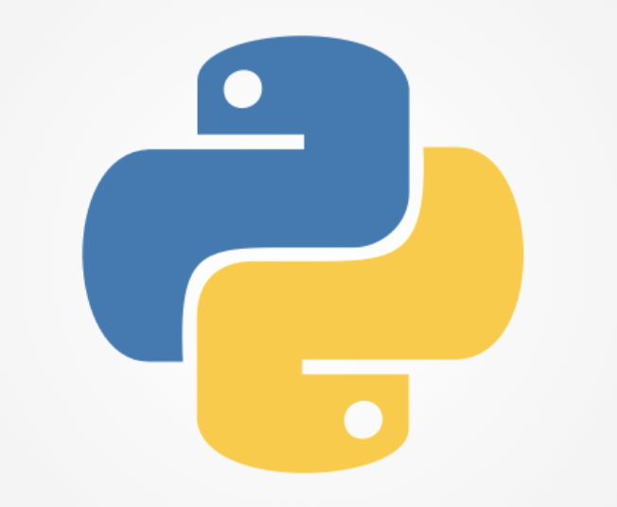
Introduction to Python
FO-Technology
Session 1

Slide 2
About the team
Can Lu
Ivan Yu
Karen Lobo
Pengfei Shan
Qiaona Hong

Slide 3
Agenda
Anaconda installation and configurations (15 mins)
VS Code and extensions installation (10 mins)
Download Github repository: http://github.com/sgpy/foconnect/tree/HongKong
First “Hello World!”
Python basics:
Variables
List
Dictionary
Plot a chart
Process data with Pandas

Slide 4

Anaconda helps in:
Simplified package management. With the availability of more than 300 libraries for data science, it becomes fairly optimal for any programmer to work on Anaconda for data science.
Deployment. It helps in getting an easily manageable environment setup which can deploy any project with the click of a single button.

Slide 5
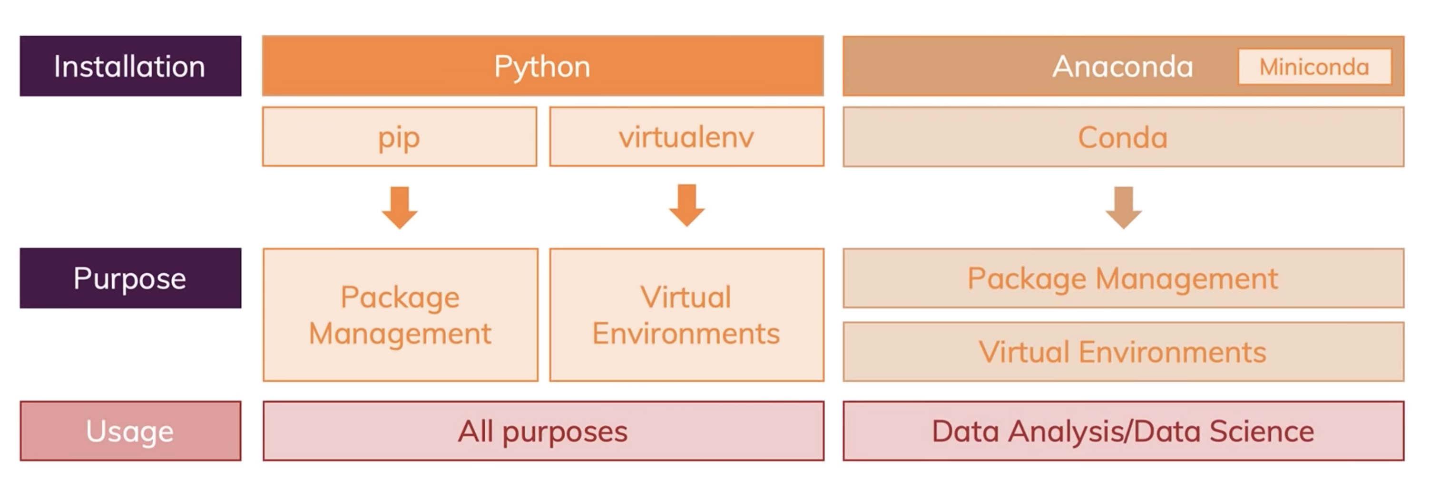

Slide 6
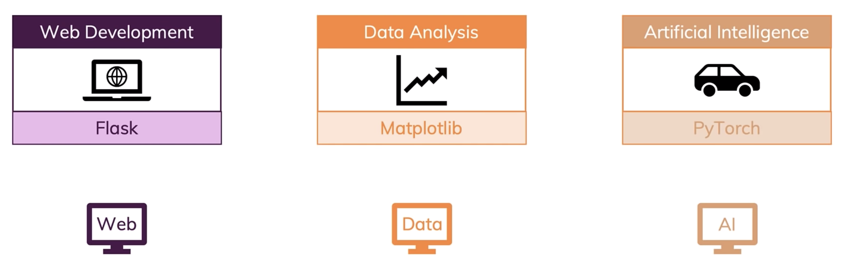
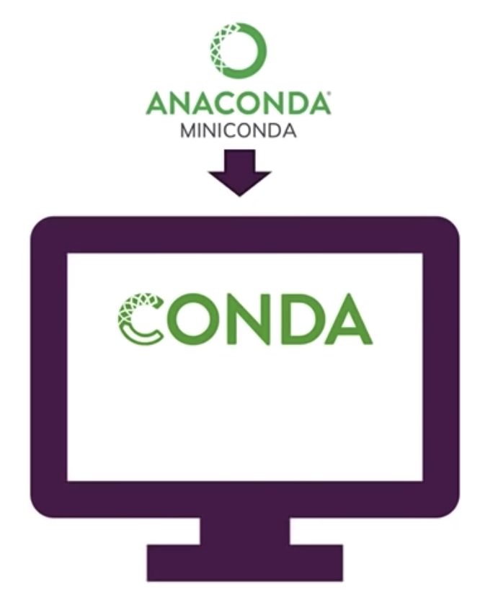
Packages and Virtual Environments

Slide 7

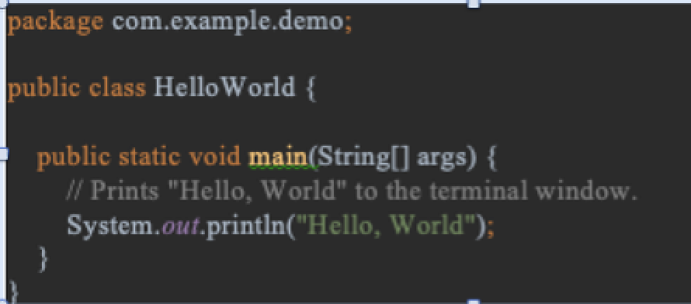

Why Python
Print “Hello World” in Java vs. Python
Java | Python

Slide 8


Why Python
Once you learn it you can find opportunities in web development, data science, machine learning, AI, web scrapping, game development, scientific and numeric computing, the list goes on, making it the versatile language to learn.

Slide 9


Why Python
Python is hugely popular and has a massive community of developers who can support you when you run into trouble.
You can find a curated list of awesome Python frameworks, libraries, software and resources here.

Slide 10
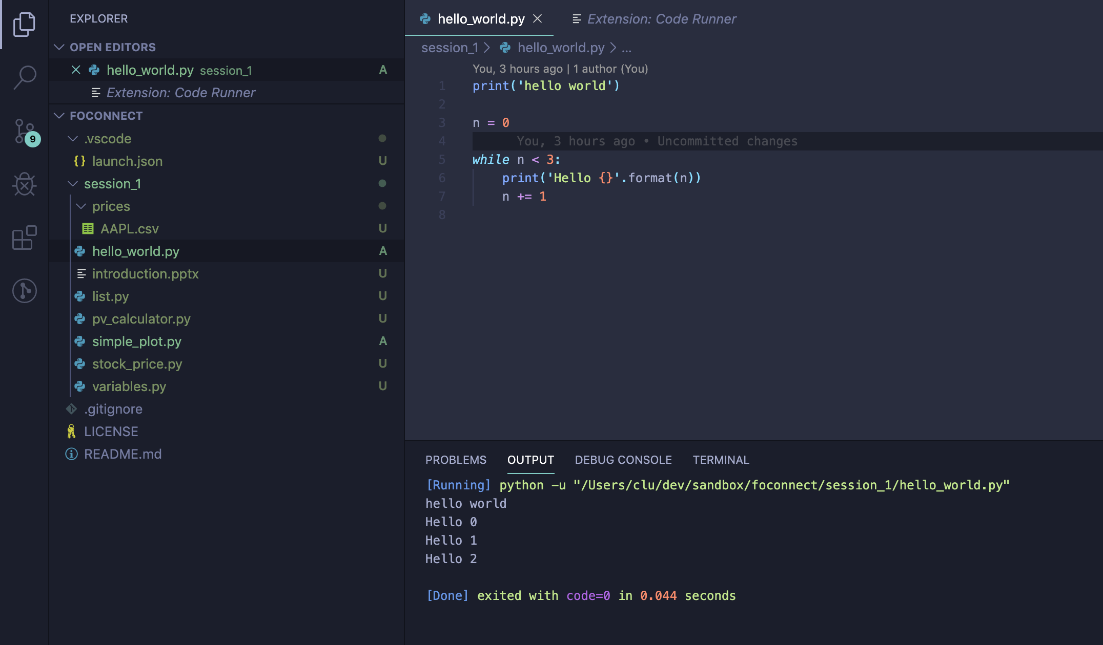
VS Code - IDE

Slide 11
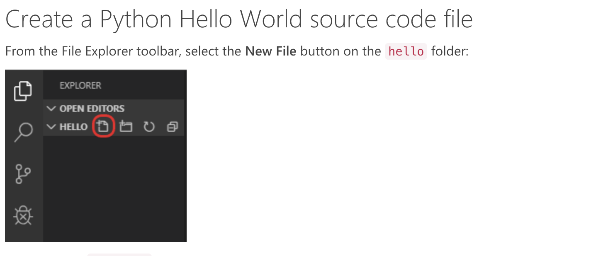
First “Hello World!”

Slide 12
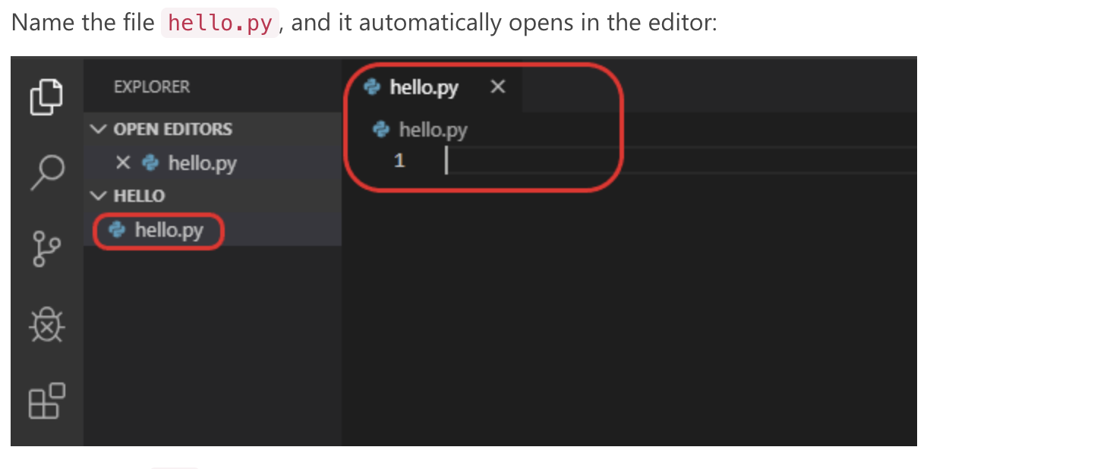
First “Hello World!”

Slide 13
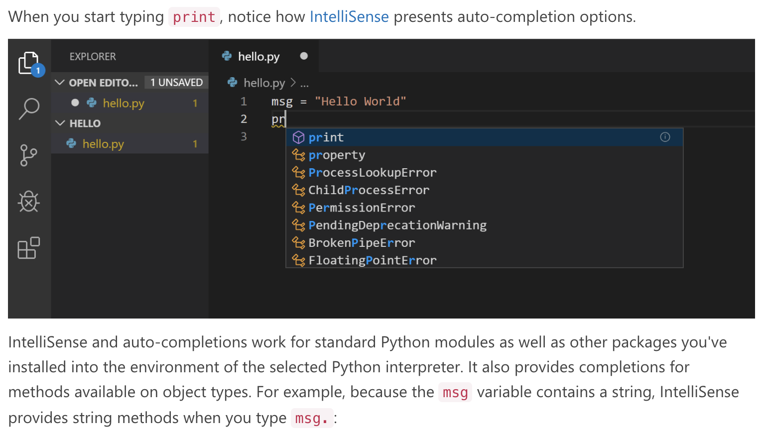
First “Hello World!”

Slide 14
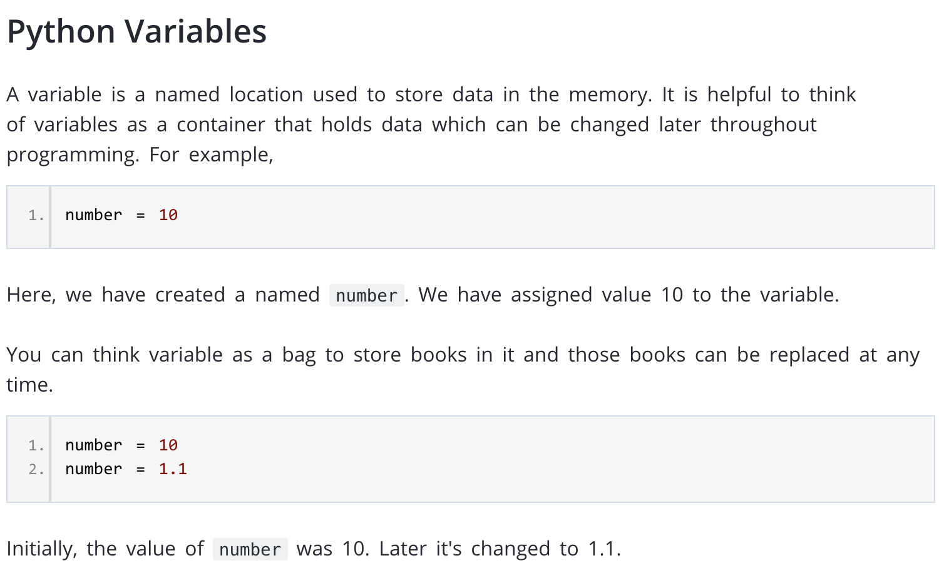

Slide 15
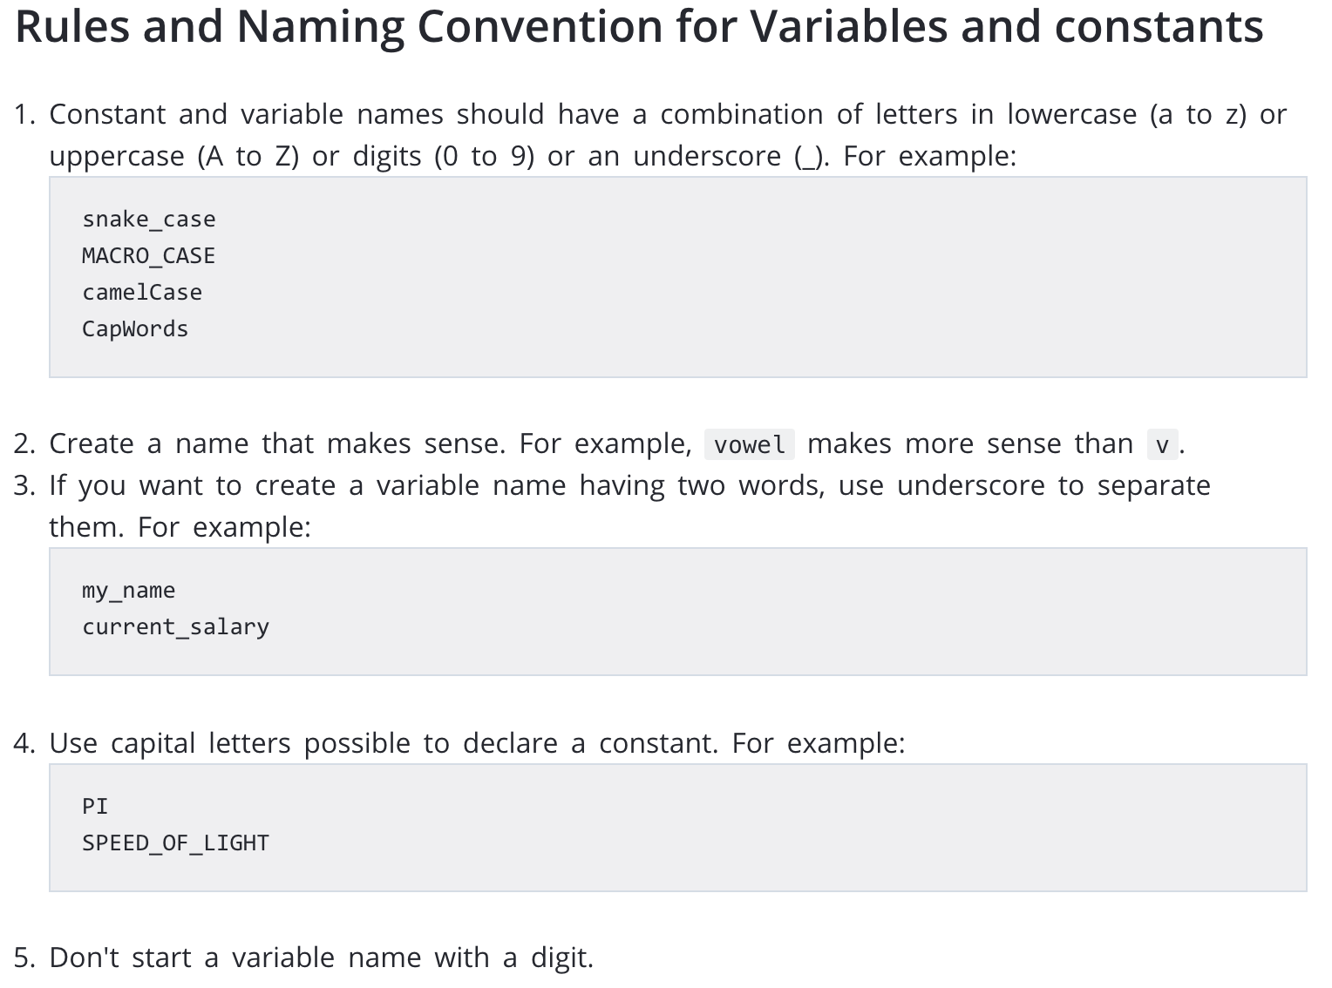

Slide 16
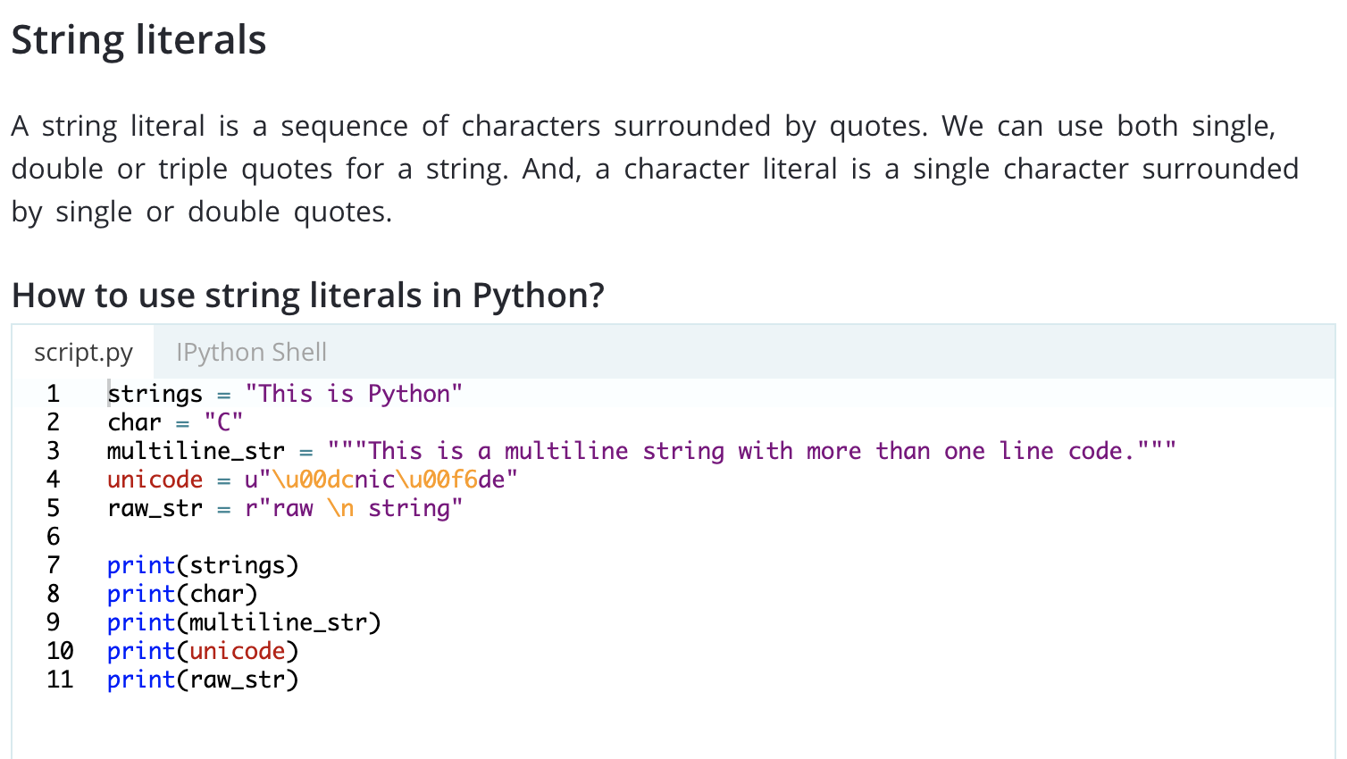

Slide 17
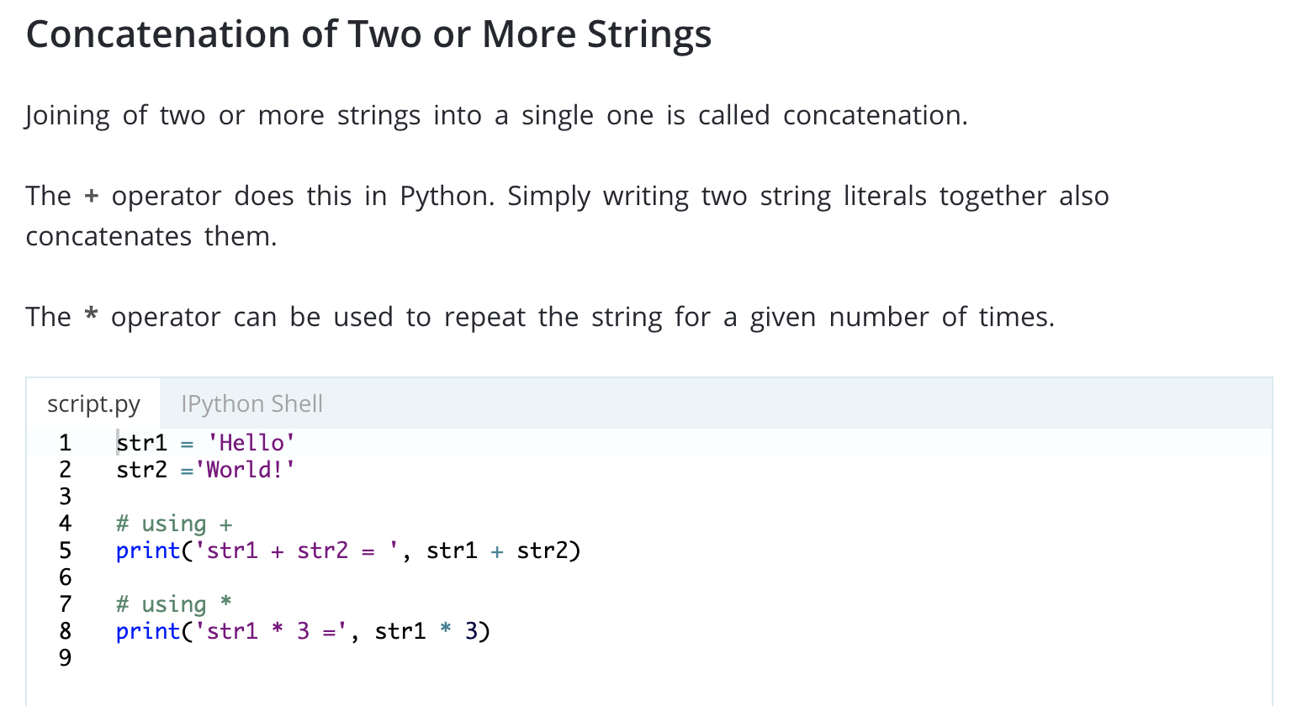

Slide 18
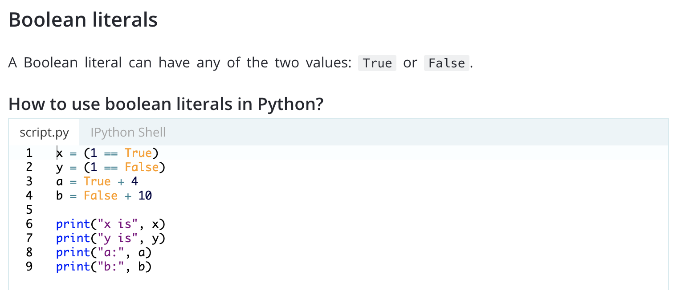

Slide 19
Quiz Time

Slide 20
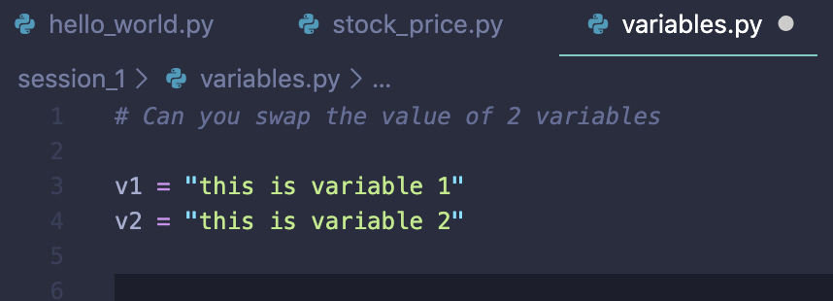
Swap values of 2 variables?

Slide 21
What is a List?
A List is a kind of Collection
A collection allows us to put many values in a single “variable”
A list element can be any Python object - even another list
A list can be empty

Slide 22
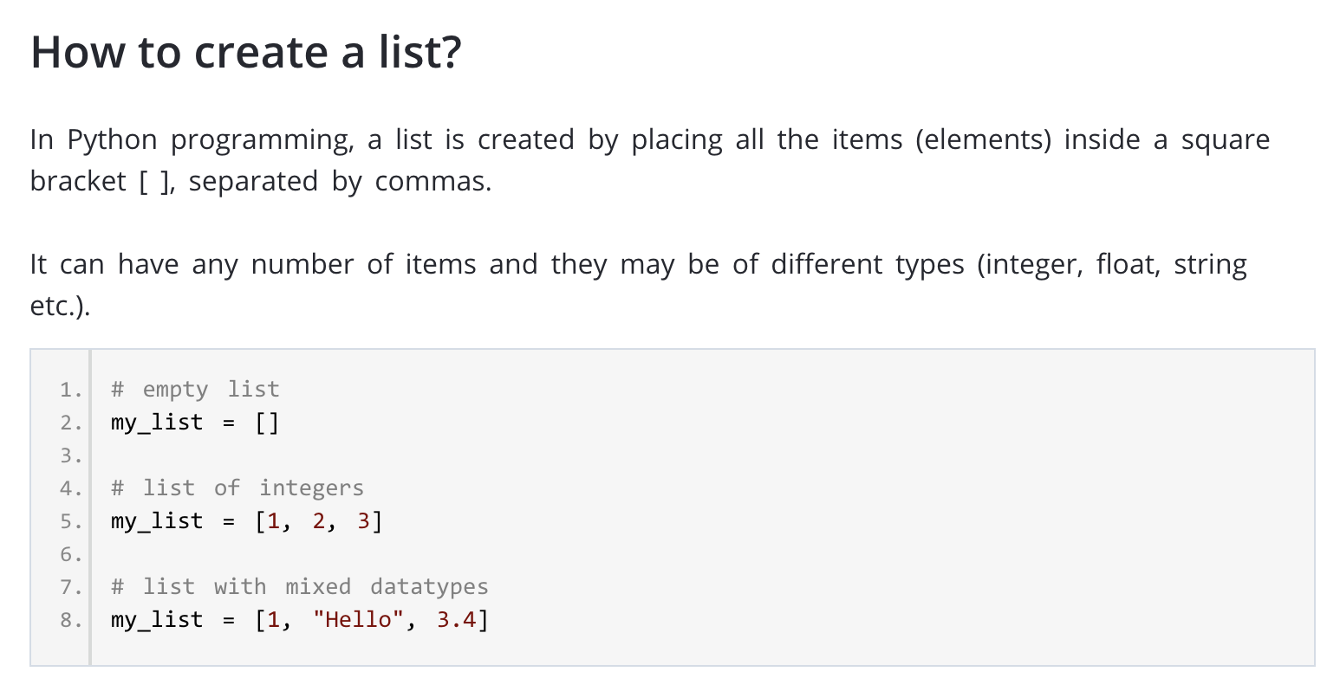

Slide 23
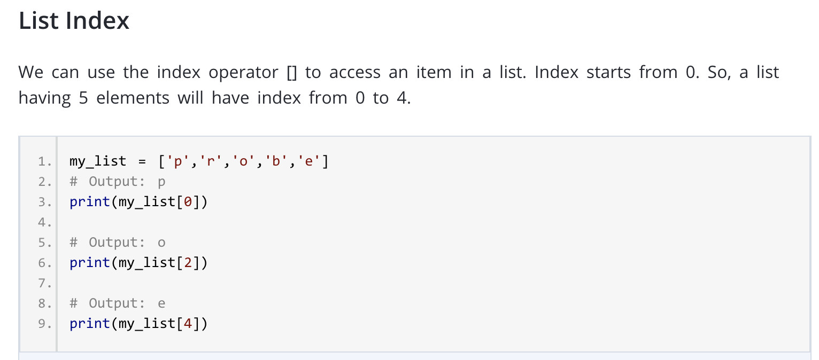

Slide 24
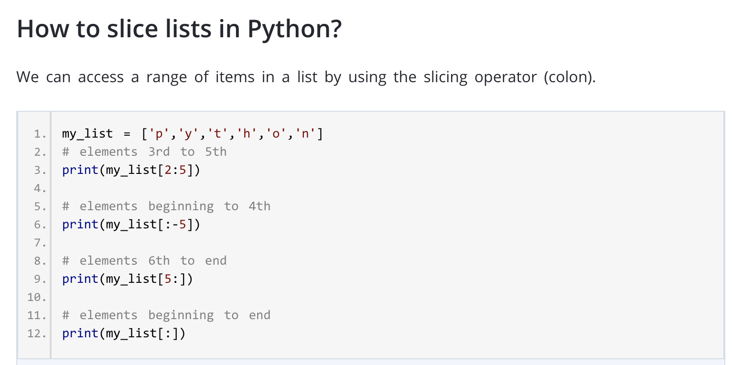

Slide 25
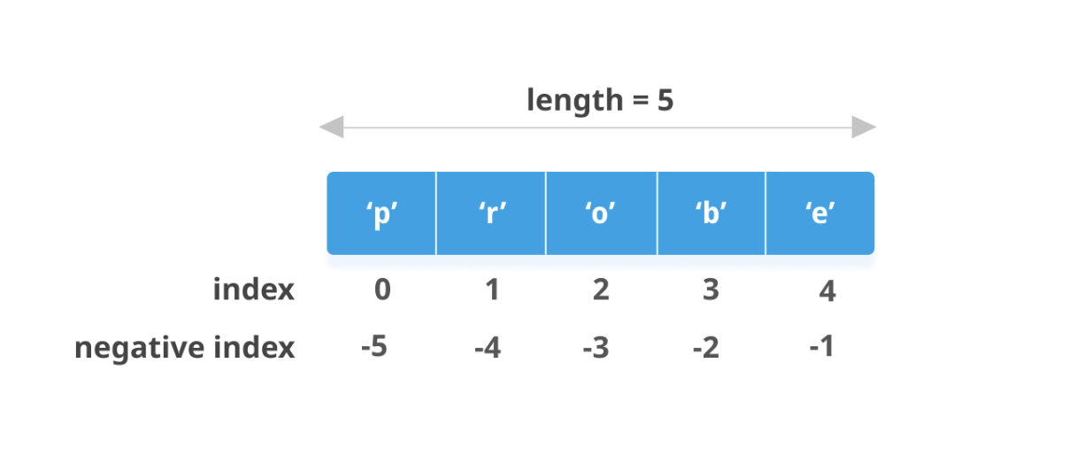
List indexing

Slide 26
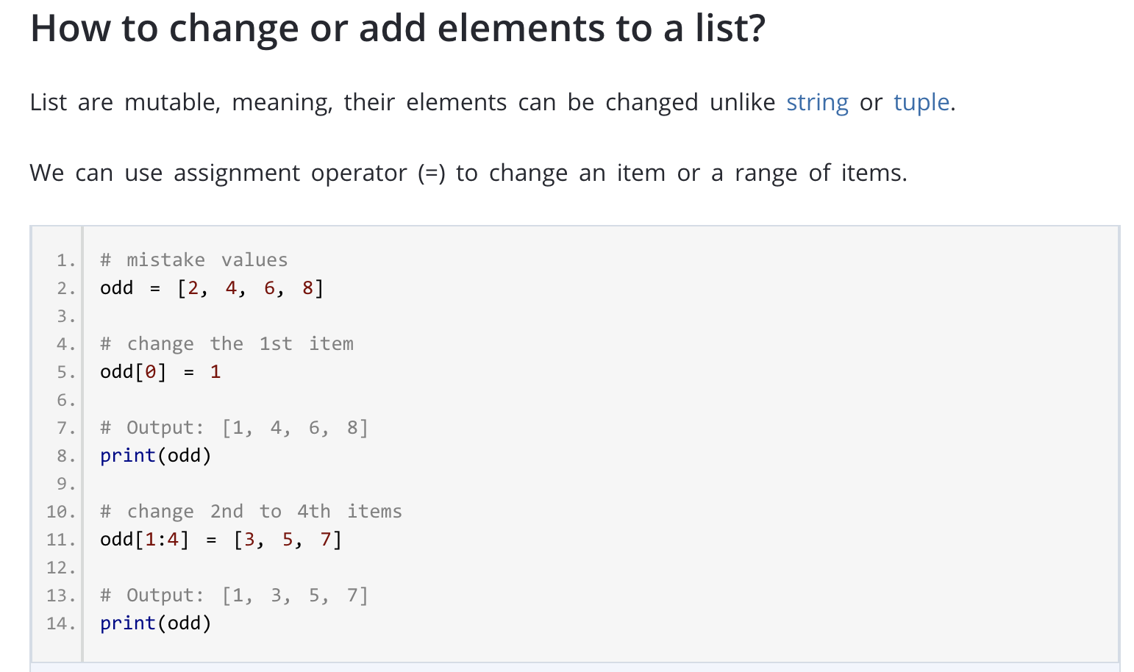

Slide 27
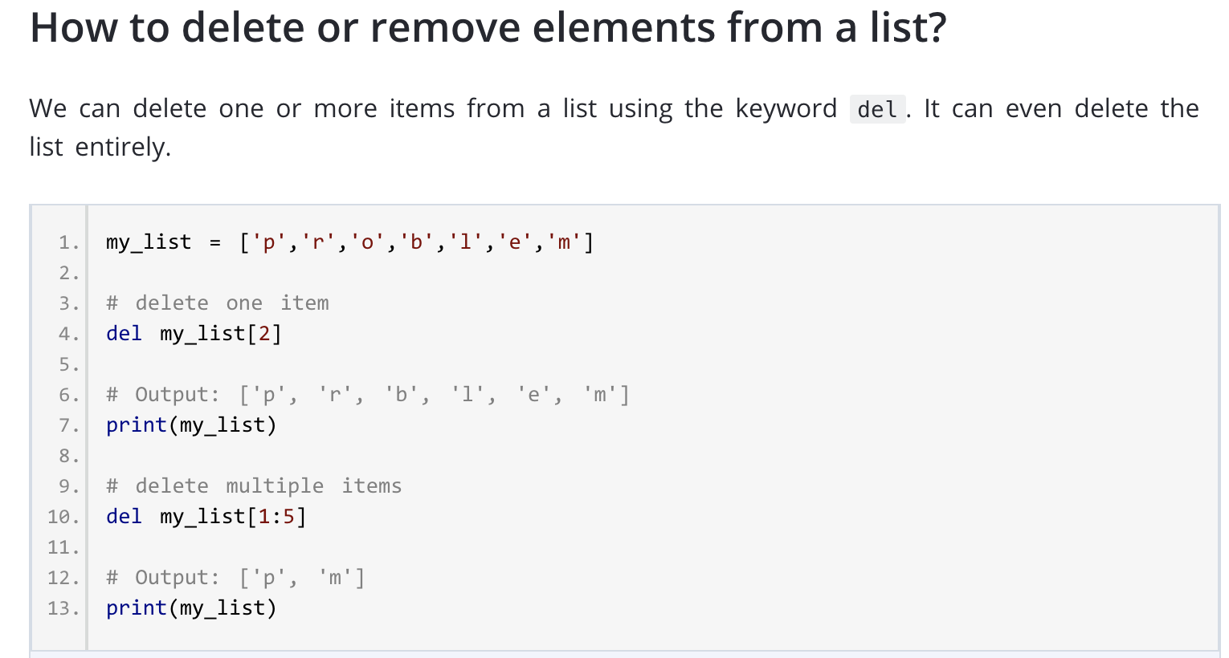

Slide 28
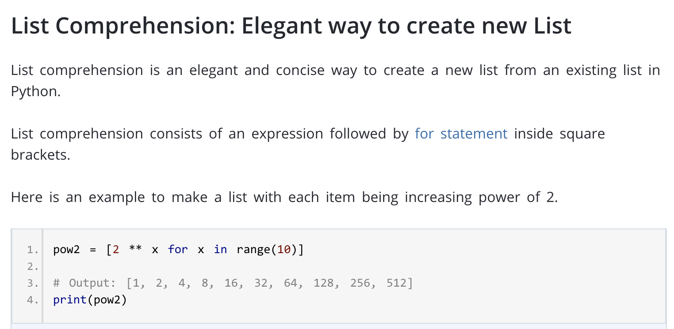

Slide 29
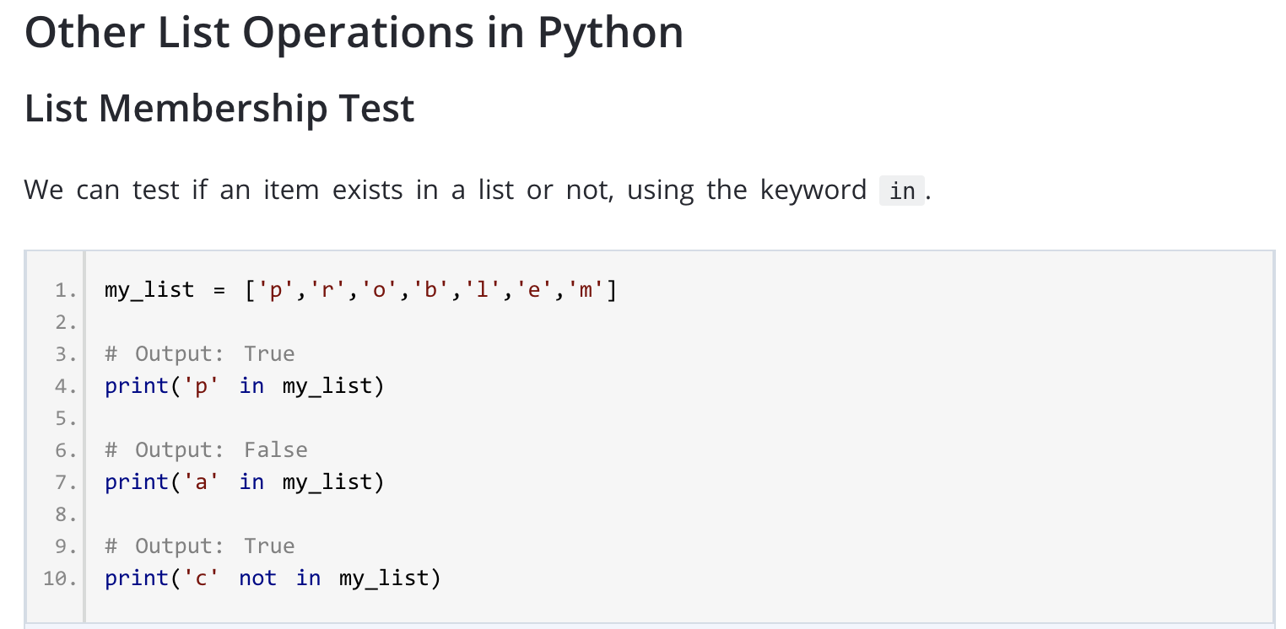

Slide 30
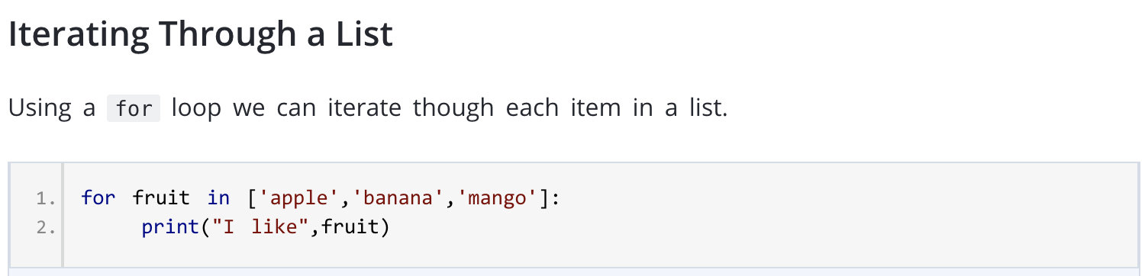

Slide 31
What is a Dictionary
Similar to look up tables
Some languages call them associative arrays or hash tables.
Unlike sequences (lists, strings, tuples) which are indexed by an ordered range of values, dictionaries are indexed by keys
Items are retrieved according to their keys.

Slide 32
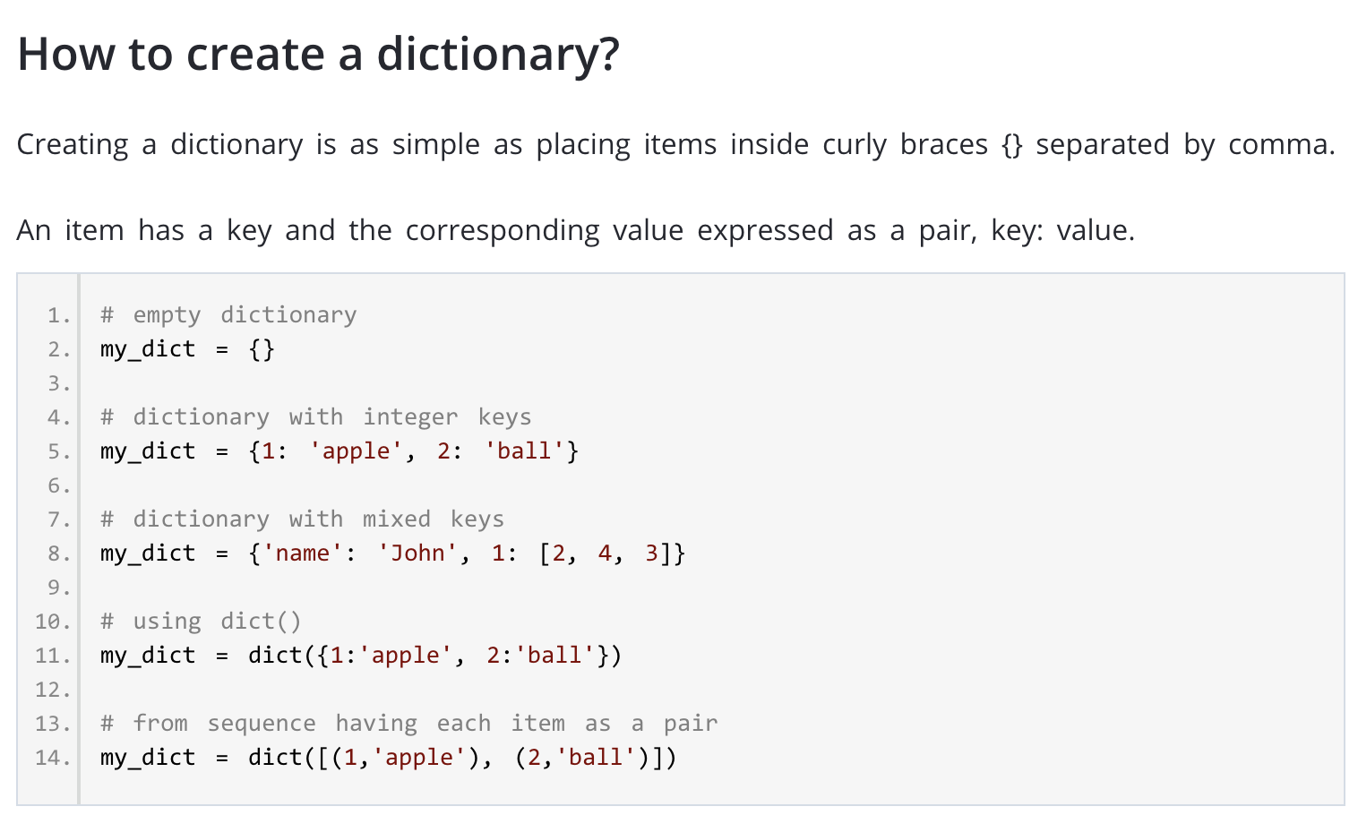

Slide 33
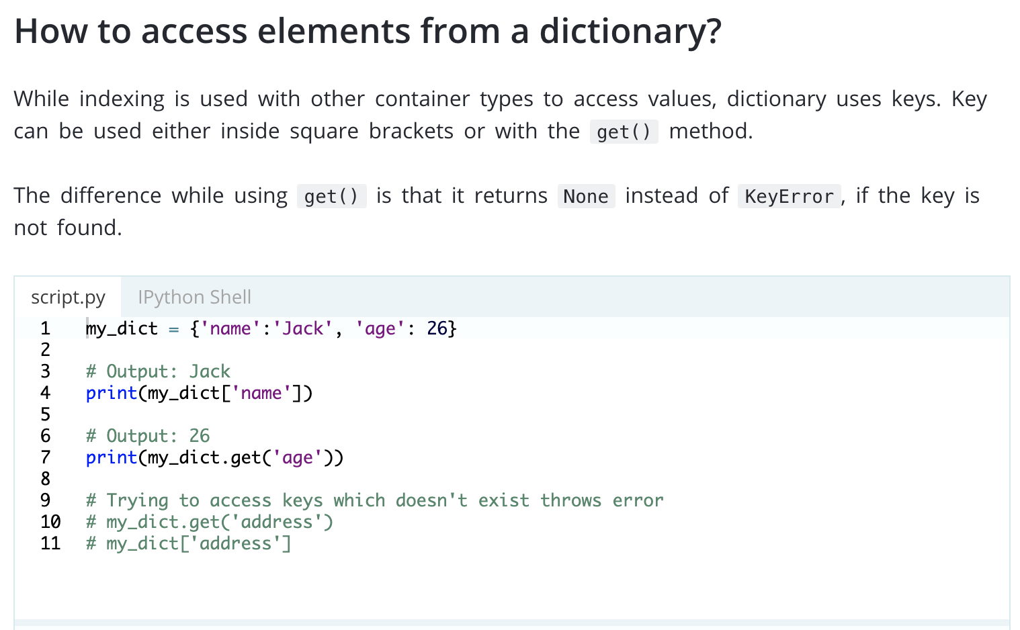

Slide 34
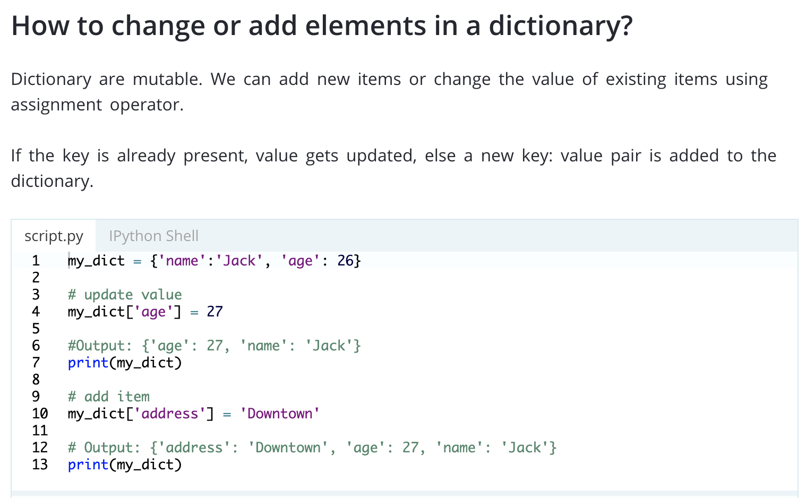

Slide 35
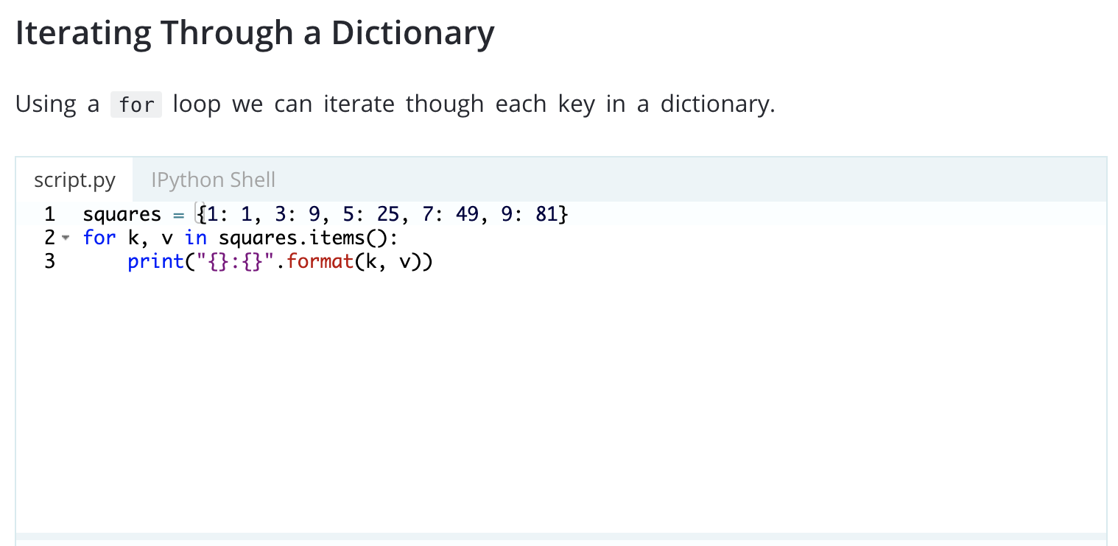

Slide 36
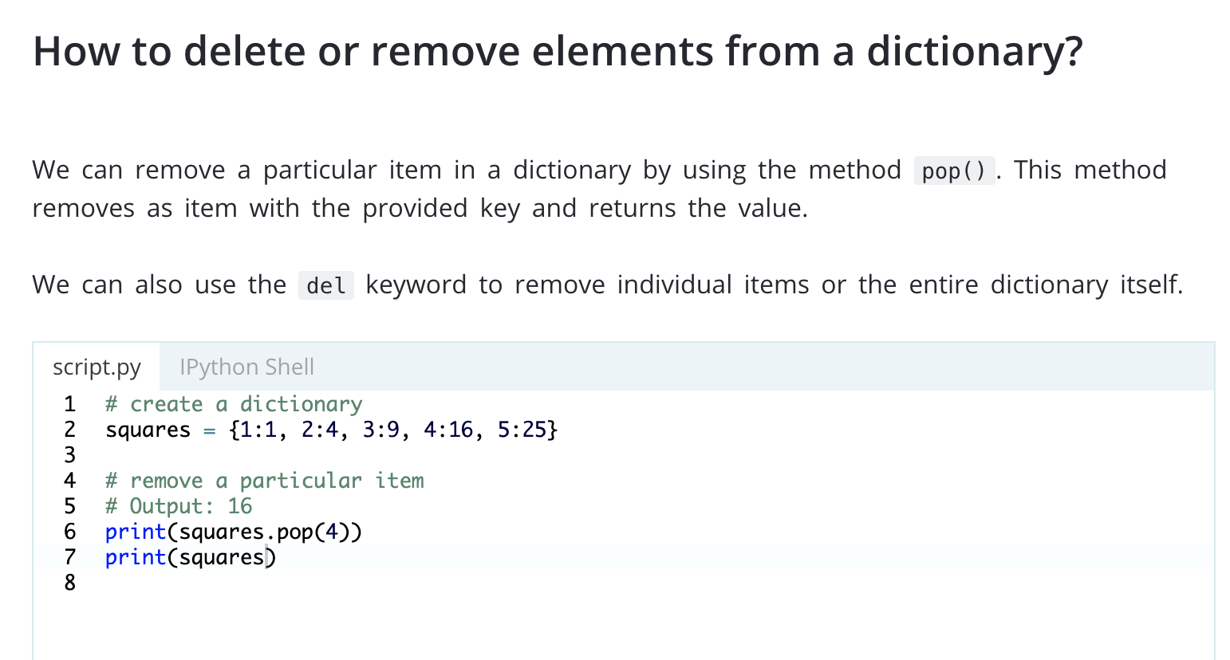

Slide 37
Quiz Time

Slide 38
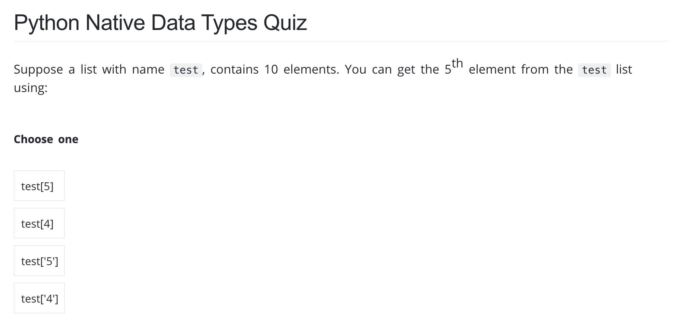

Slide 39
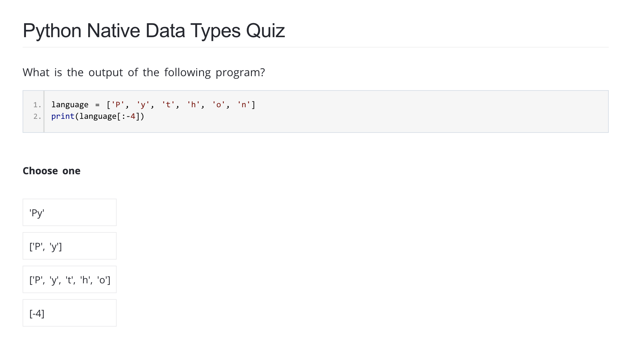

Slide 40
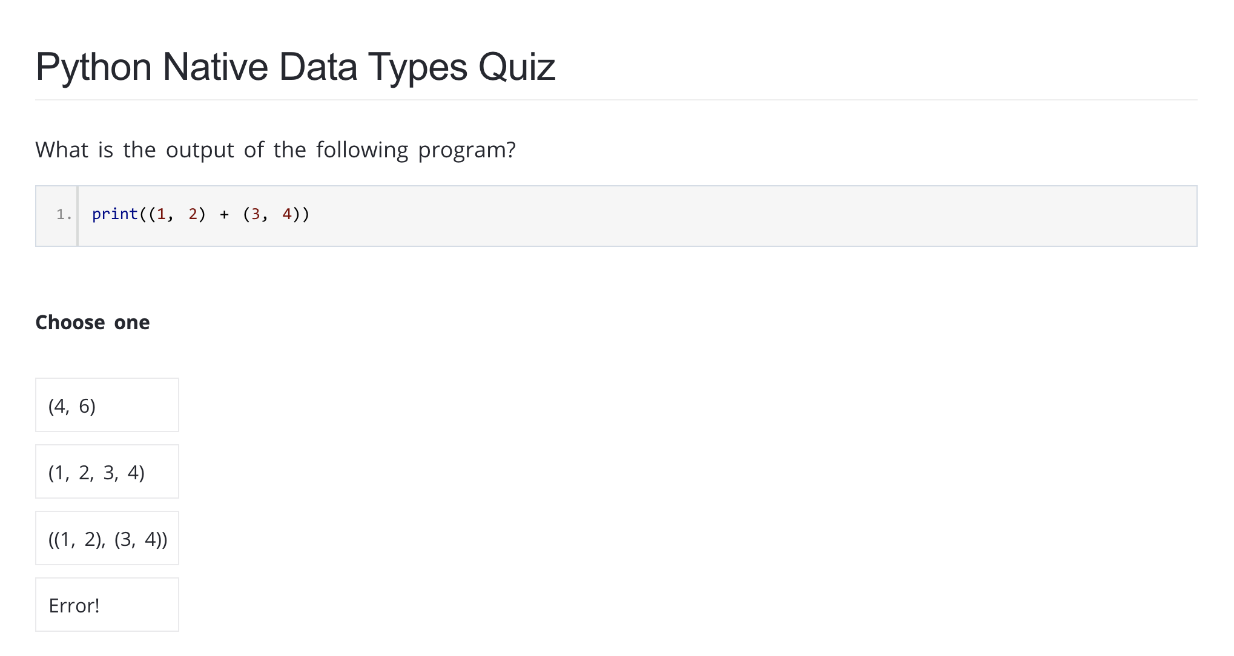

Slide 41
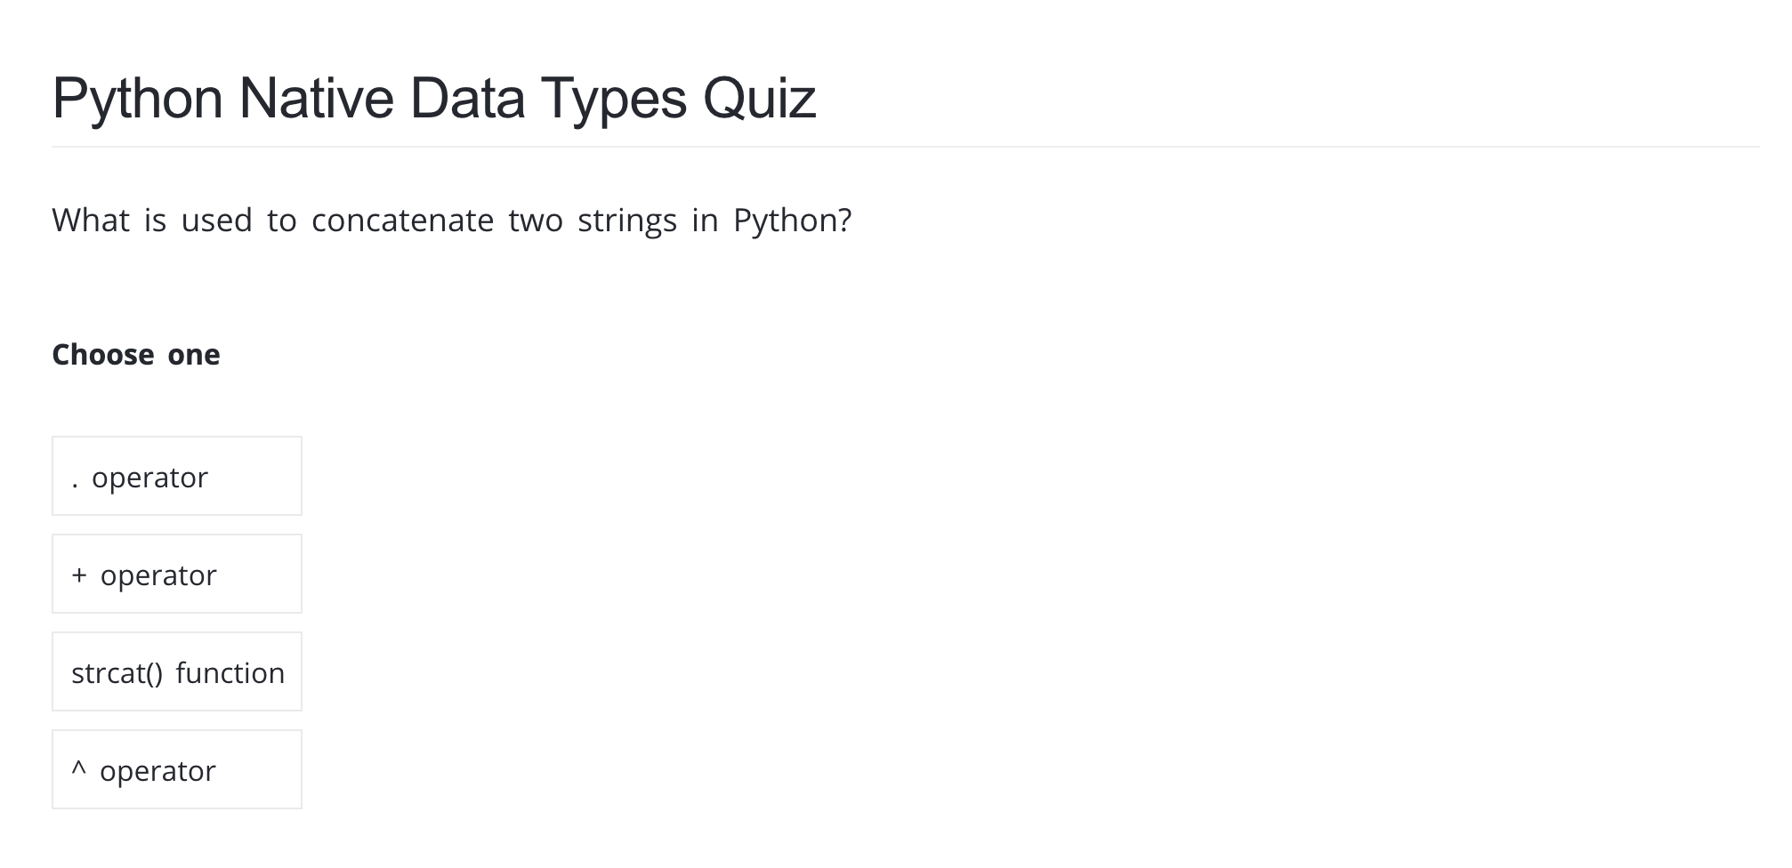

Slide 42
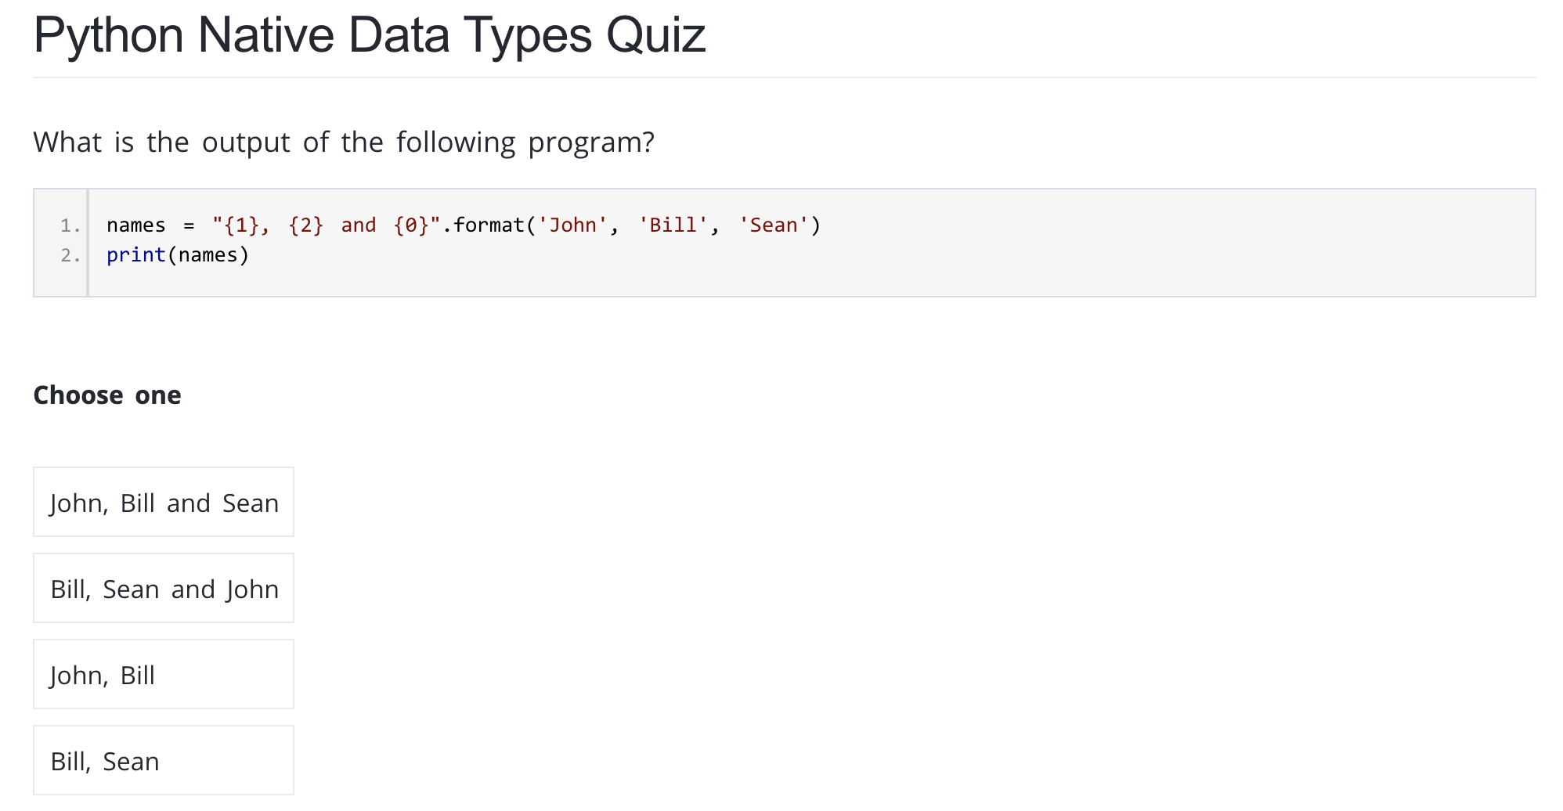

Slide 43
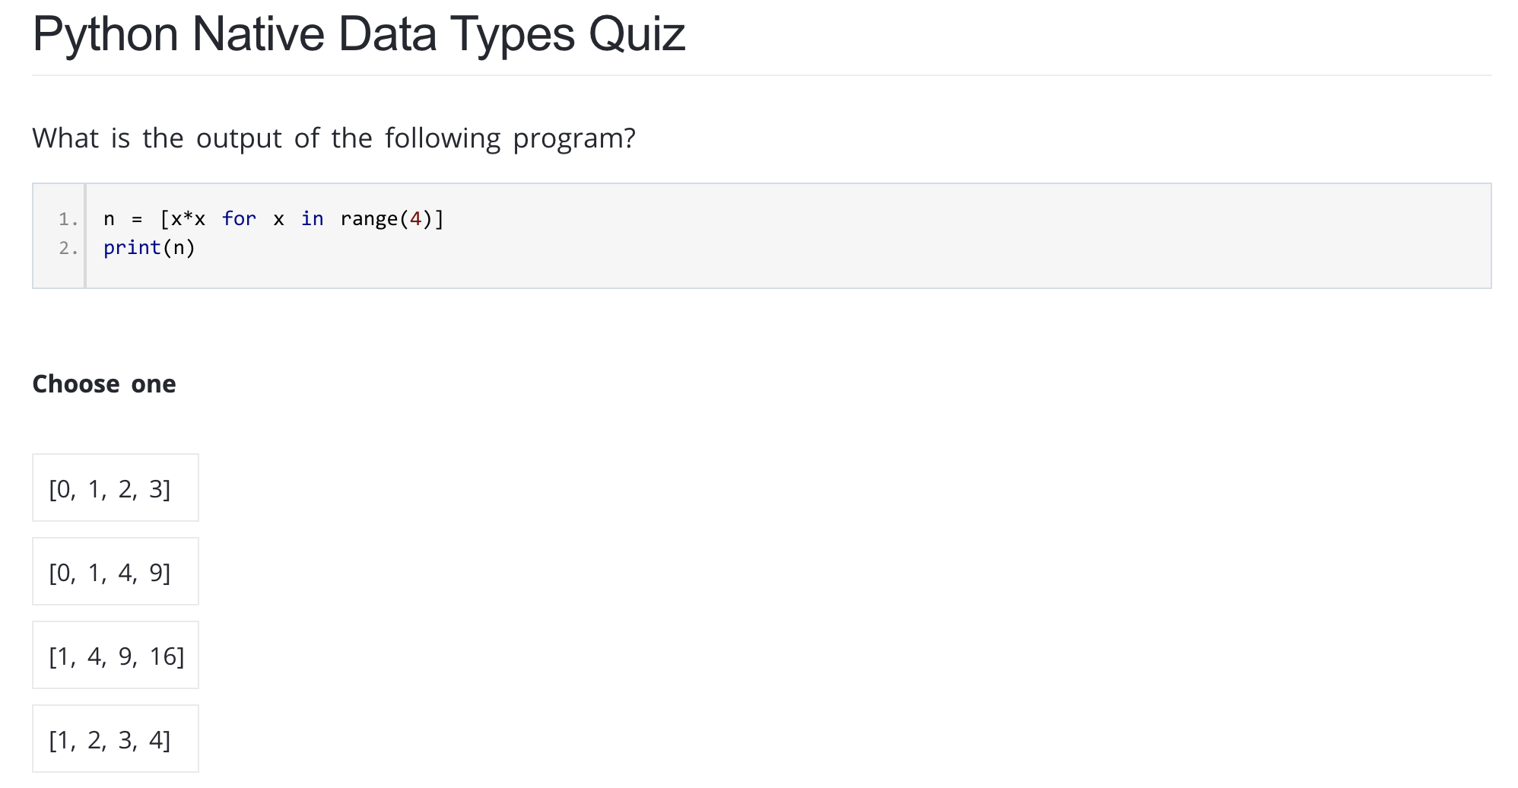

Slide 44
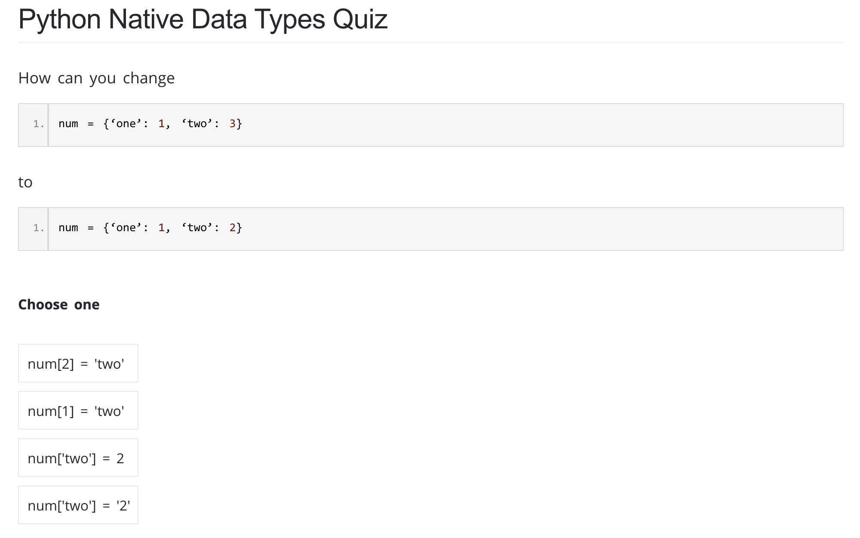

Slide 45
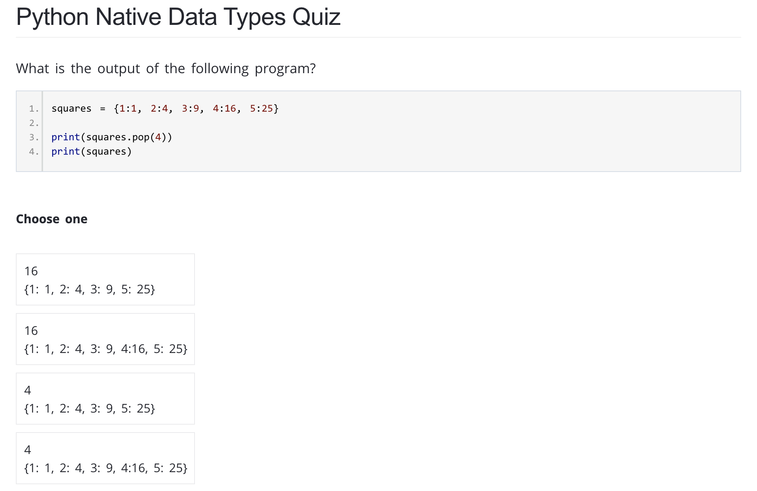

Slide 46
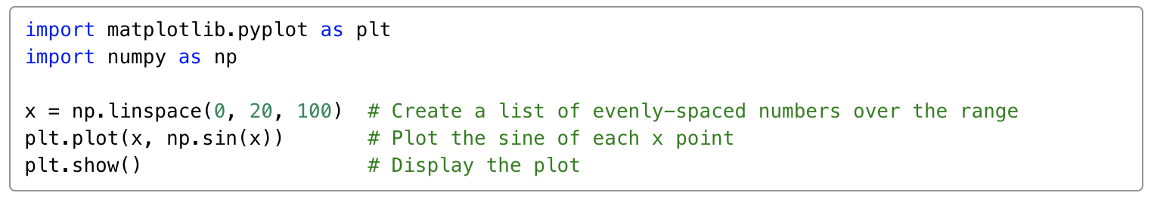
Plot a chart
Chart plotting with matplotlib. It’s a popular data visualization library for Python, the reason why we choose it because it’s fairly easy to use and out of many Python data visualization libraries it’s the most commonly used one.

Slide 47
Processing data with Pandas
Python library that helps you import, organize and process data. We will cover more details for data processing in the next session.

Slide 48
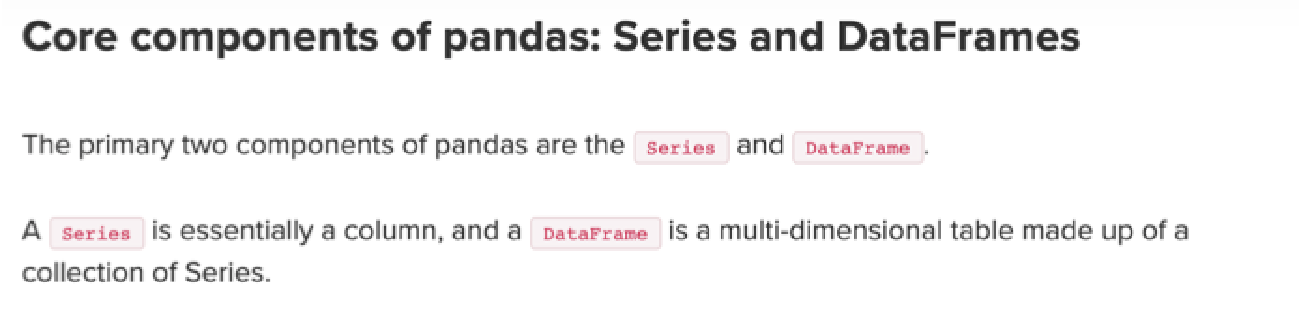
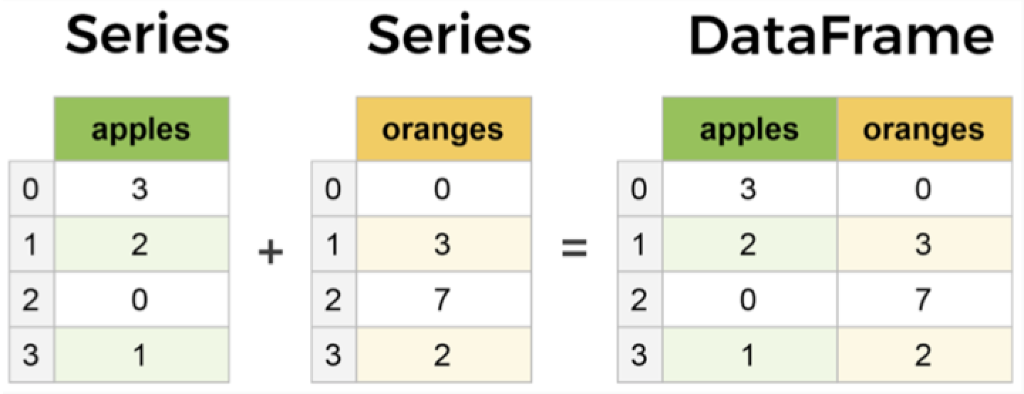

Slide 49
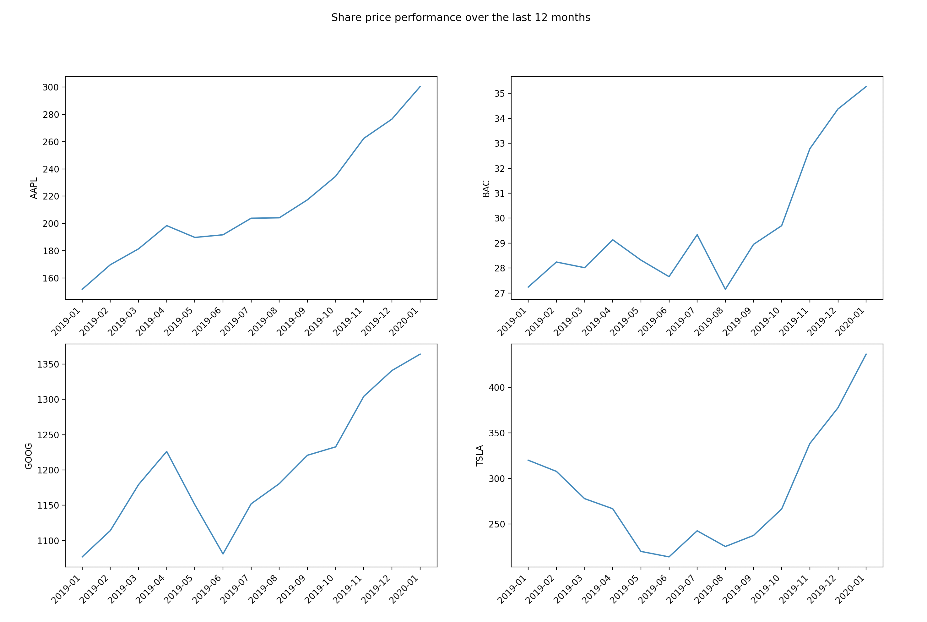
Share Price example

Slide 50
Final Projects Suggestions
A simple trading strategy which listens to live market data, produce signals and place dummy orders with back testing result.
Face recognition app which helps to organize photo albums.
A Flask web application for managing investment portfolios
Yield curve generation/curve analytics
NLP, a simple chat bot which understands simple English
A Poker game
…...

